Slide 1
For Your Safety and Protection Safe Environment Tenth Grade

Slide 2
Notes:
Jesus understands pain, fear and suffering because He experienced them, and He wants to support and strengthen you by His love when you are lonely, uncertain or anxious.

Slide 3
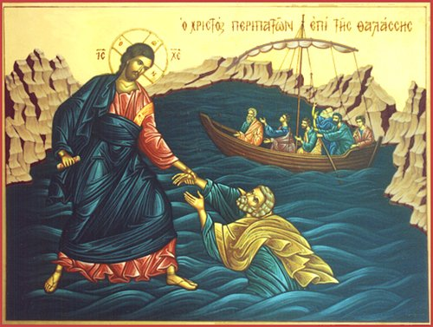
Notes:
We see in this Scripture passage that Jesus reached out His hand to save Peter in the water when Peter began to sink because of his doubt.
When you look at the Cross, Jesus’ open arms invite you to receive His love by opening your heart to Him in prayer and receiving Him in the Sacraments.

Slide 4
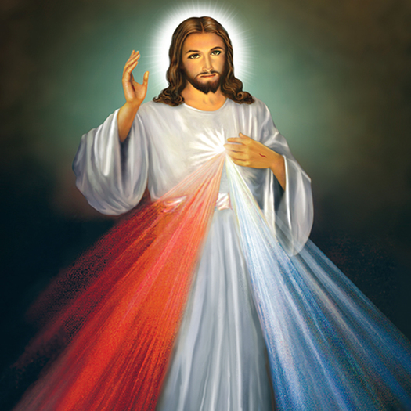
“Jesus I trust in you.”
Notes:
Jesus I trust in you.
You can trust Jesus. He has given everything so that you can know the difference between following Jesus or following the father of lies (the devil), selfishness, sin, and death. A great saint of the last century, St Faustina, taught us this simple but powerful prayer: “Jesus, I trust in you.”

Slide 5
Notes:
God created you in His image and likeness. That means that you are a beloved son or daughter of God. He dwells within you. When “the Word became flesh,” God Himself took human form and so made you holy. That means that your body and soul are precious in the eyes of God. When you reflect carefully about this great truth, you can better decide how to make important choices, for yourself and for others, so that you will always act in a way pleasing to God. To strive to please God in all things will not necessarily make for an easy life—Jesus told His disciples that we must carry the Cross after Him—but it will make for a fulfilled and happy life, because He promised this.
When you ask yourself the question, “Who am I?” Remember this: You are a child of God and He dwells within you, unless you choose to separate yourself from Him.

Slide 6
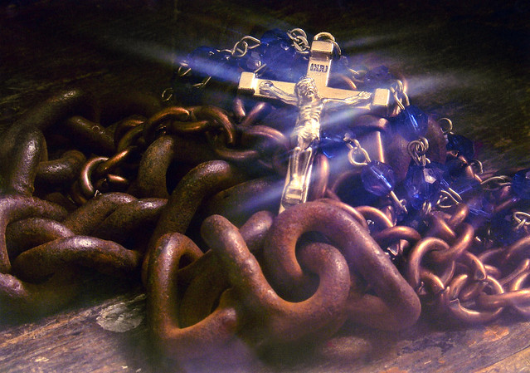
Notes:
You and I can be friends of the Lord because He greatly desires it. At the Last Supper, just before giving the gift of His own Body and Blood in the Eucharist and before dying to redeem each and every person on the Cross, Jesus said, “I no longer call you slaves, …I call you friends” (John 15:15).
Until Jesus gave His life for you in the Eucharist and on the Cross, we were not redeemed, we were not released from the slavery of sin. The chains of selfishness and sin were not broken and the gates of hell were not destroyed until Jesus laid down His life for each person. Every human person could rightly be called “slaves” before the Passion of Christ. What a great blessing that Jesus is able, and greatly desires, to call you not a slave but His friend. And what a blessing that He keeps freeing each one of us from the bondage of sin through His mercy, breaking the chains of our addictions and the bad habits that enslave us. Jesus came to set captives free, so that we could become His friends. This is the heart of the Good News of Christ.
Your relationship with Christ should model your relationships with others in that people are not to be used for your own desires, nor are you to be used for other people’s desires. True friendship does not enslave, rather, true friendship leads the persons to a deeper relationship with Christ.

Slide 7
Notes:
“A new command I give you: Love one another. As I have loved you, so you must love one another. By this everyone will know that you are my disciples, if you love one another.” - Jesus
Your deepest yearning is to love and to be loved, for you are not meant to be alone.
God, who is love, has created you for a relationship of love with Him and with other people.
God’s love is pure self-gift, and He has created you in His image and called you to mirror that self-giving love.
It is only in the gift of self that you will find true fulfillment and joy.
True friendship means that you need to love your friends enough to lead them away from paths that separate them from God. True friendship means saying no to sin for the good of yourself and the other person. Our secular culture says that to love others, you must accept everything they do. But true love is loving others enough to steer them from the things that could harm them and accompany them on the path to discover who they truly are as a child of God.
When we live by the “golden rule”, doing to others what we would have them do to us – treating each person with respect, compassion and authentic love – we manifest the love of Our Father, completing what He has done for us.

Slide 8
Where do you see God?
Notes:
God is good and only wants what is best for you.
In your daily life, you need to play your part by seeking to protect yourself from sinful behaviors with their damaging effects, as well as by guarding against situations that are dangerous and people who may cause you harm. God has given you a Guardian Angel who is always with you, seeking to guard and guide you. Pray the Guardian Angel prayer each day to remind you of this.
Remember that believing and trusting in God does not mean you won’t go through suffering, but it means that you have an ally who walks with you through the suffering. You are never alone. Perhaps the best thing to remember is that God understands suffering first hand. Look at Jesus Christ, the second Person of the Holy Trinity. He was fully God and fully man, and in the Gospels we read about how He suffered in the last days of His life: physically, emotionally, spiritually, and psychologically. He suffered every way a human being can suffer. So when you are suffering remember, He understands, and He is present. Trust in His presence, love, grace, and mercy of our Lord.

Slide 9
Practical steps
to avoid potential danger:
Notes:
The following are practical steps to avoid potential danger.
Avoiding potential danger means being careful to avoid certain situations, and praying for the courage to speak up with friends to help avoid situations that could make you and them vulnerable to harm.

Slide 10
Talk to your parents!
Remember, just making a grunting sound is not really communicating.
Notes:
Talk to your parents.
Let them know what is going on in your life. Talk about the good and the bad. Opening up to your parents, even a little will mean the world to them. The more you improve your communication with them, the stronger your relationship will be. Let them in and be part of your life by letting them know where you are at all times, who you are with, etc. Let them know where you are at all times. Make sure your parents know of any regular meetings or correspondence (email, etc.) with an adult, school counselor, priest, youth minister, etc.
Your parents are not your enemy. They are a gift to you from God to love you, which is manifested through their concern for every aspect of your life. This love is more than words; it is shown through their support, guidance and protection.

Slide 11
Ask questions, think ahead and use good judgment..
Notes:
Ask questions, think ahead and use good judgment. Pray for the strength to say no to plans that could be unsafe. Take time for silence so that you can learn to recognize the inner promptings of the Holy Spirit, who will guide you on the right path.
Remember that sometimes in situations that are unsafe, or just not a good idea, that there is probably someone or several people waiting for someone else to speak up and say, “This is not a good idea.” Asking questions is not a sign of weakness, but a sign of strength that you are thinking. Be brave, and don’t be afraid to be a leader and to take a stand.
You are at the age when you and your friends are starting to take on the responsibility of driving. While this provides you with more freedom, it also is a place where you could be faced with more temptations. This is the time when you need to cling to your faith even tighter. Don’t let temptation rob you of the firm foundation of your faith.

Slide 12
Notes:
Always be aware of your surroundings, and trust your instinct that a situation could be dangerous.
Sacred Scripture, the very Word of God, lights our path to what is good, true and beautiful – to what brings peace, joy and fulfillment. Read the Word of God in Sacred Scripture a few minutes each day, beginning with the New Testament. Pray for the grace to be obedient to where the good God is leading you.
Christ, and your relationship with Him, is what lights your path. Remember that you have a relationship with Christ where He is with you every second of every day. You never walk alone, but allowing Him to light your path is a way for you to see Him at work in your life, first hand.

Slide 13
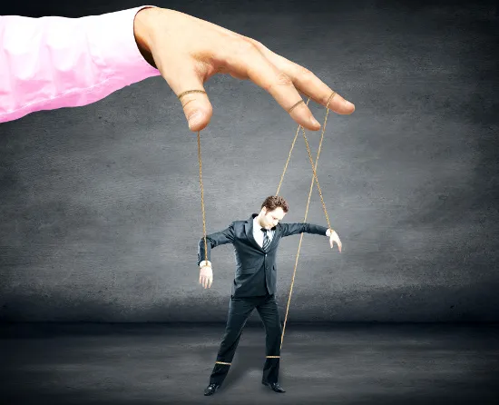
Guard against relationships that involve deception, manipulation, intimidation or exploitation.
Notes:
Guard against relationships that involve deception, manipulation, intimidation or exploitation.
The key to a good relationship is how we treat each other. Sometimes people who are misguided see a relationship the same way they see a possession. A good relationship requires mutual respect and love for the God-given dignity of yourself and the other person. People are to never be treated as objects or possessions. If you are being treated as an object or a possession, then you should tell a trusted adult and completely break free from that relationship.
Do not use another person or allow yourself to be used. Respect the rights, dignity and worth of each person.
Using another person can be done in a physical form and/or psychological form. Sometimes people allow themselves to be used because they want to be liked. But true friendship does not use another person and no friendship is worth being taken advantage of in any form.
God gave us the beauty of free will. This first thing we should do with free will is to choose to love God. We should never allow another person to control our mind, or our actions.

Slide 14
The language you use can spread like fire.
Notes:
The language you use can spread like fire. Your words have an effect. Refrain from using foul language and sexually offensive humor in conversations.
“Consider what a great forest is set on fire by a small spark. The tongue also is a fire… No human being can tame the tongue. It is a restless evil, full of deadly poison. With the tongue we praise our Lord and Father, and with it we curse human beings, who have been made in God’s likeness. Out of the same mouth come praise and cursing. My brothers and sisters, this should not be. (By analogy) Can both fresh water and salt water flow from the same spring? My brothers and sisters, can a fig tree bear olives, or a grapevine bear figs? Neither can a salt spring produce fresh water.” (James 3:5-6, 8-12)
Your words have meaning. They can be used to love and build people up or they can be used to cut people down. They can be used bring the Gospel message to people, or they can be used to cause people to stray from God in their thoughts and in their words. The way you speak has an effect on others. When you speak, others are likely to feed off of you and be an echo of your words. So, ask yourself, “Are your words building up or tearing down, leading to God or away from God?”

Slide 15
You are a person to be loved, not a body to be used.
Notes:
The way you dress is important. It is how you present yourself. Wear clothing that does not draw specific attention to one part of your body. You are a person to be loved, not a body to be used. Therefore, you will want to dress modestly.
“Modesty is more than just a hemline, it is an interior disposition that influences not only your dress, but your thoughts and actions.” Leah Darrow (pictured) That interior disposition is: Live with respect for yourself and the assurance that you are a son or daughter of God.
How do you present yourself as a child of God? What is it about you that helps people instantly recognize that you are a child of God?

Slide 16
Notes:
Use the “2 by 2” principle: Having a trusted friend you know you can depend on.
Use the “2 by 2” principle – when with an adult or out with people your own age, always be with a trusted friend who you can depend on. Therefore, always go places in groups. Commit to looking out for one another’s well-being, always knowing where the other person is.

Slide 17
Notes:
Avoid numbing your conscience with drugs and alcohol.
Avoid drugs and alcohol. When people are intoxicated, they are completely unsafe, physically and spiritually, because their consciences are numbed and they are unable to make good decisions. Avoid others who are intoxicated. Even people you know well cannot be trusted in that state.

Slide 18
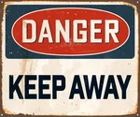
Stay away from someone who has abused another person
Notes:
If you know of someone who has abused another person, they should not be near you.
Many times someone who has abused another person before will do it again. They tend to see people as objects and/or possessions. They truly need professional help to understand other peoples’ dignity and worth.

Slide 19
Communicate your concerns
Notes:
Communicate your concerns
Communicating your concerns means telling someone in authority when you are uncomfortable with a situation or a person, and most especially if you have been abused or you suspect that someone else may have been abused. Pay attention to your own intuitions/feelings. Even if abuse is not occurring, it is still important to let others know when you have concerns. Remember the following:

Slide 20
Be a true friend even at the risk of upsetting him/her by “overreacting”.
Notes:
Communicate your concerns
Be a true friend even at the risk of upsetting him/her by “overreacting”. If you are worried that a friend is being/has been abused, tell someone in authority. If you have sought help from someone in authority and that person does not take action, tell another person in authority.

Slide 21
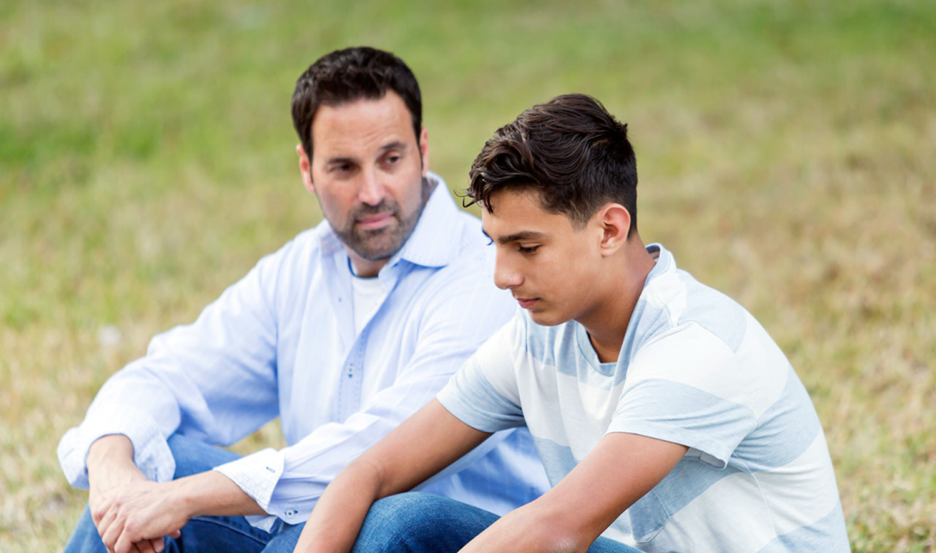
If you have been abused, speak with a trusted adult about it.
Notes:
Communicate your concerns
If you have been abused, it is not your fault, even if you have not followed the steps listed above to avoiding potential danger. Do not fear being blamed. You will not be. Speak with a trusted adult about it. DO NOT KEEP IT A SECRET. Jesus said, “The truth will set you free.”

Slide 22
Pay attention to your own intuitions/feelings.
Notes:
Communicate your concerns
Communicating your concerns means telling someone in authority when you are uncomfortable with a situation or a person, and most especially if you have been abused or you suspect that someone else may have been abused. Pay attention to your own intuitions/feelings. Even if abuse is not occurring, it is still important to let others know when you have concerns. Remember the following:
There is a network of help at home, in friends, at school, in the Church, and in various other organizations. There is always someone to turn to in every situation. Specifically:
Always talk to your parents about your concerns.
Notify a church official, principal and/or
Do not hesitate to call the police.
If you or someone you know has a tendency to sexually destructive behavior – contact someone in authority (anyone mentioned above) for help before you or someone else gets hurt. There is no shortage of help for those who seek it.

Slide 23
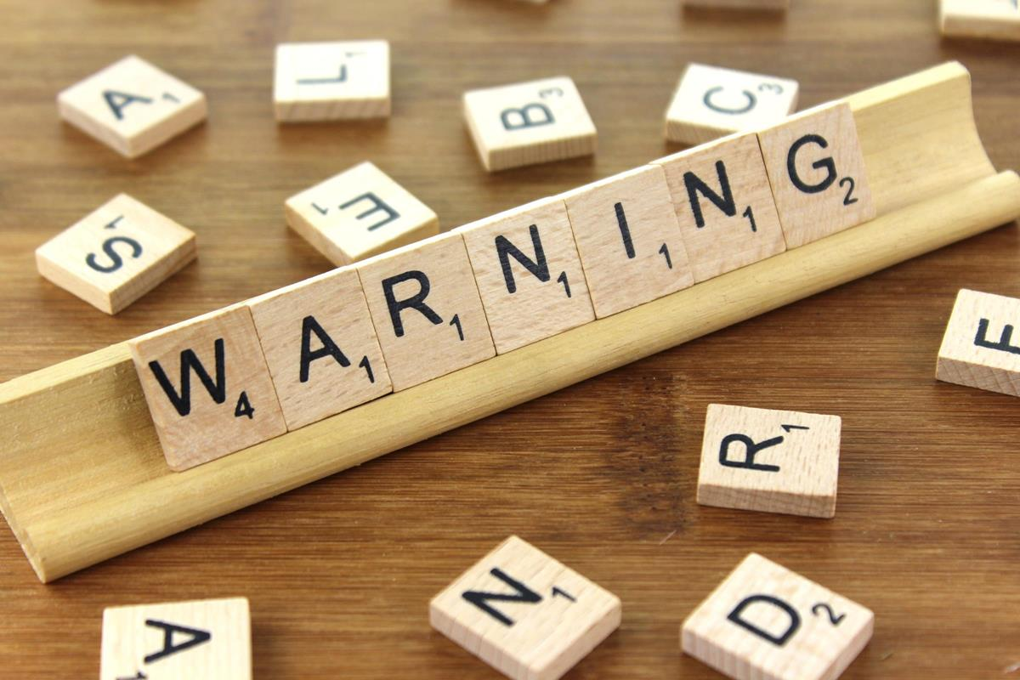
Know the warning signs.
Notes:
Know the warning signs of a potential predator:
Always wants to be alone with young people.
Gives gifts to young people often without permission.
Goes overboard touching. Is not respectful of a young person’s comfort zone.
Thinks the rules do not apply to them.
Allows young people to engage in activities their parents would not allow.
Uses bad language or tells dirty jokes to young people.
Shows young people pornography
Don’t be fooled, realize that most molesters:
Look like everyone else.
Are often in a trusted role with young people
Sometimes use their church association to gain trust.
Can be very patient while they plan the abuse.

Slide 24
Remember
God loves you very much!
You have incredible worth as a child of God.
You, and every person, are to be treated with respect.

Slide 25
If you are being harmed, or if you feel sad, scared, unsafe, or uncomfortable then tell an adult that you trust right away!
Notes:
Discuss your safety plans with your parents and ask for their guidance when you are planning an outing. “What should I do if…” Always tell your parents where you are going, with whom you are going, and the time that you will return so that they can find you if needed.

Slide 26
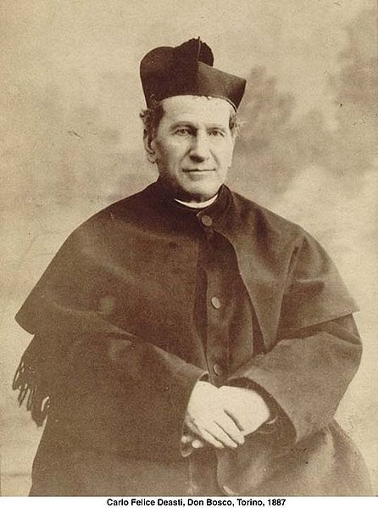
Notes:
The prayer to St. John Bosco, the patron of youth, in the virtue of respect, Diocesan Virtue Program, page 3. diolc.org/catechesis/understanding-and-living-the-virtues/respect.
Make a copy for each student:
O Saint John Bosco, father and teacher of youth, you labored so much for the salvation of souls.
Help us to respect ourselves and each person as a child of God. Be our guide in seeking the good of our souls and the salvation of our neighbor.
Teach us to love Jesus in the Blessed Sacrament, Mary the Mother of Christ and our Mother, and our Holy Father the Pope. Obtain for us from God the grace to one day be gathered all together with you in Heaven. Amen.

